Slide 1
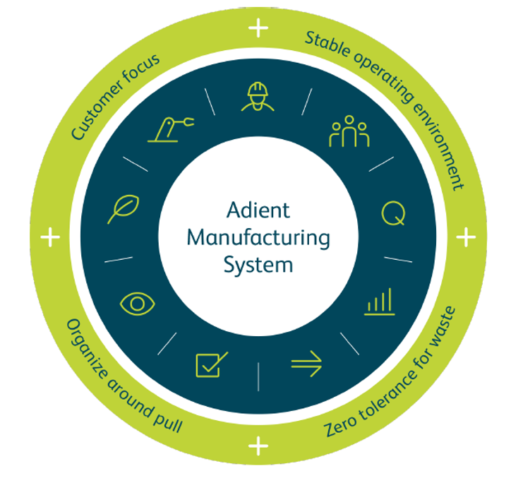
The Adient Manufacturing System (AMS)
One Adient Way of manufacturing to attain world-class performance. We are engaging employees, driving operational excellence and growing our business.
Notes:
Together we are on a journey to become the most operationally capable company in our industry. The first step in is to embrace a One Adient Way of manufacturing to attain continuous world-class performance.
We call this our Adient Manufacturing System (AMS).
Through AMS we will engage employees, drive operational excellence and grow our business.

Slide 2
Manufacturing excellence
Adient Manufacturing System (AMS)
Operating system
Knowledgeable and skilled people; thinking and acting to continuously adopt and improve AMS
Organizational model and systems to manage AMS effectively
Mindsets and behaviors
Management infrastructure
Interdependent across three dimensions
Notes:
All 3 all critical to achieve manufacturing excellence, the three dimensions must work together. If we do not have all three, the results will not be sustained.
ONE operating system at all plants around the world -- our Adient Manufacturing System (AMS).
Manufacturing Infrastructure: This is more than staffing. It also includes learning and development for employees, High Performance Teams, governance and the workflow.
Mindsets and Behaviors include 4-core components:
Visibly role modeling the next generation AMS behaviors
Clearly communicating the what, why and how of AMS
Ensuring people have the right skills to improve the maturity
Reinforcing the right behaviors and ensuring old habits will not come back

Slide 3
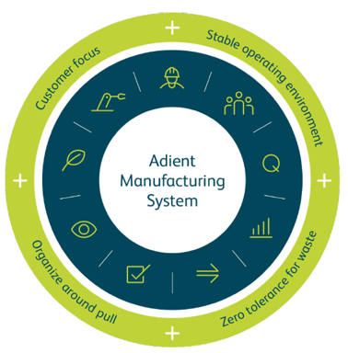
Four building blocks
Foundation
Principles
Maturity Model
Action Plan
Notes:
AMS has the guiding ideals, practices and standards that govern how we make things. It also includes common metrics to assess our performance, the tools we can leverage, and even the way certain things should look and feel in every plant, everywhere. Our new system has FOUR BUILDING BLOCKS:
4 foundational concepts,
9 principles,
1 assessment,
and 1 action plan.
Our system has four key components: 4 foundational concepts, 9 principles, 1 assessment, and 1 action plan. The foundational concepts include: customer focus, ensuring a stable production environment, organizing around customer pull, and exercising zero tolerance for waste. The 9 principles provide a comprehensive model for managing any manufacturing facility. These principles have a set of manufacturing practices that provide a path for maturing a team’s capability level. There are also a common set of metrics for each principle. And there are a set of required standards every single plant must meet over time. It all comes together in an assessment tool that can be used to determine each plant’s unique maturity level. Finally, and most importantly, the system will help plant managers develop and author their own unique plant action plan. This action plan provides a path for capability and performance improvement.
This system becomes a core platform to delivering ongoing operational excellence, raising employee engagement, and ensuring we are equipped – from a manufacturing perspective – to meet our growth targets and goals.

Slide 4
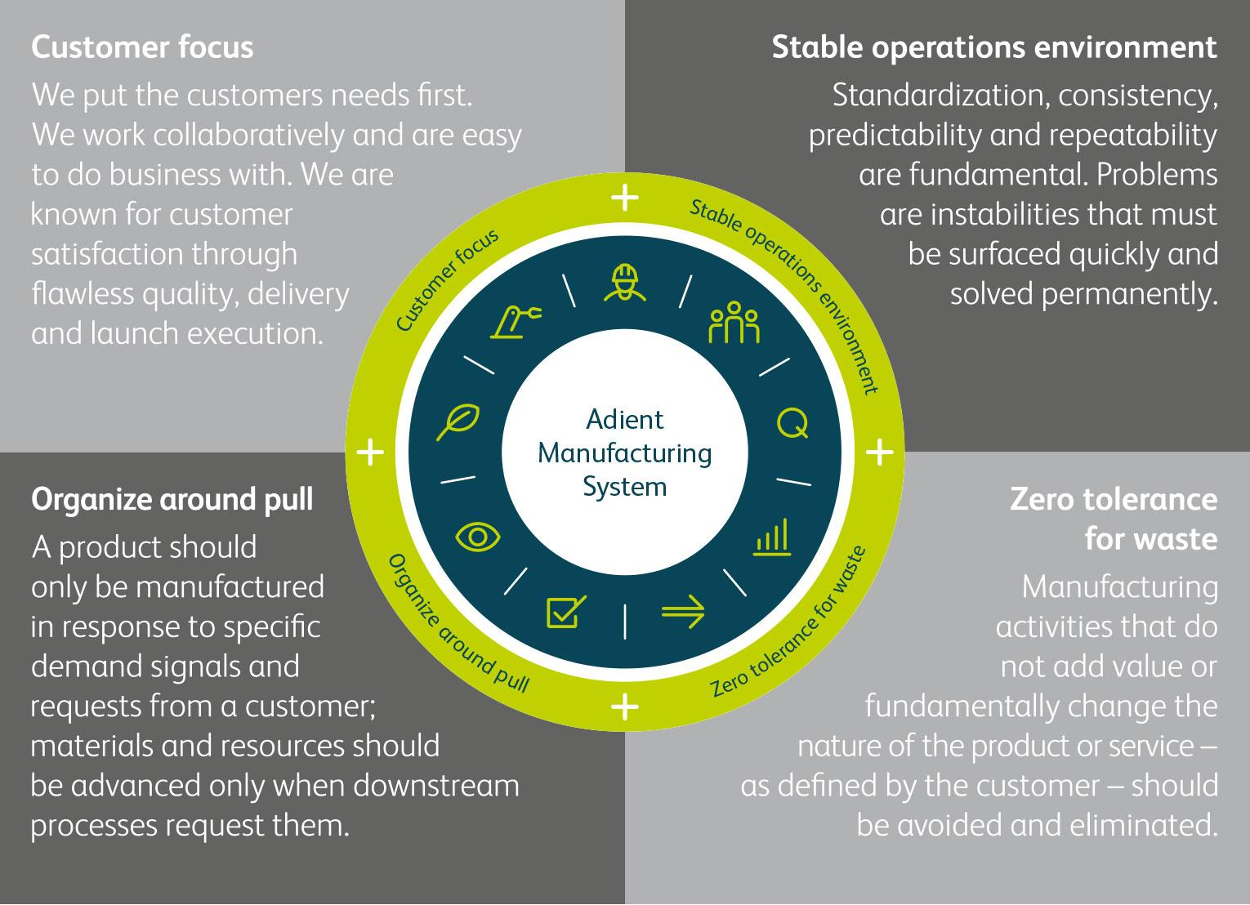
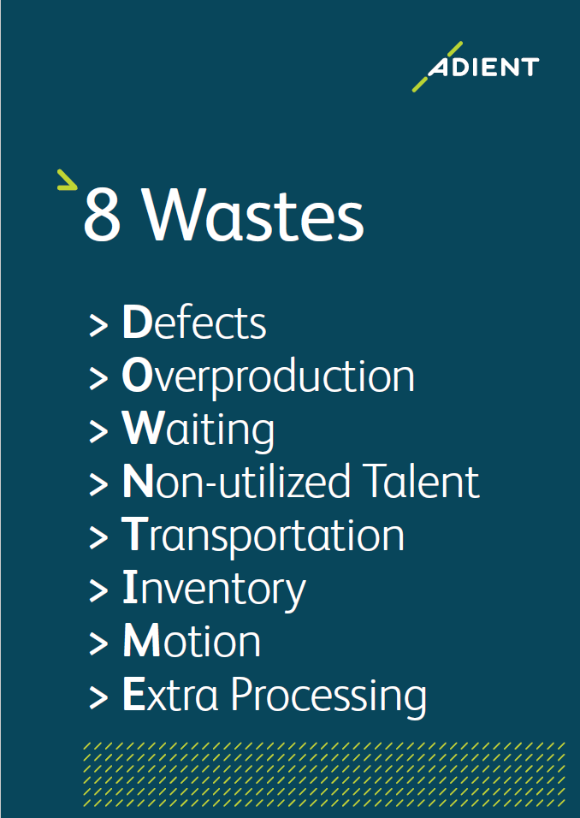
Four foundations and eight wastes
Notes:
Based on benchmarking and research internally and externally, we have created a manufacturing system with four key foundations:
Customer focus
Stable operations environment
Organize around Pull
Zero tolerance for waste
Something about the 8 wastes…

Slide 5
Maturity model provides blueprint for plant teams
Level 5 Distinguished
Breakthrough advancement is being achieved through total engagement of the shop floor
BWI Detroit’s current working stage
Level 4 Excellent
The practices of manufacturing excellence are embedded in the mindsets and behaviors as second nature
Level 3 Meets
Meets the practices and achieves manufacturing excellence
Level 2 Developing
Pockets of compliance exist, but not consistent throughout the entire plant
Level 1 Unmet
There is no evidence of the standard practices being met or achieved
Notes:
The AMS includes an assessment tool that evaluates a plant’s capability and maturity level based on its practices and adherence to enterprise-wide standards. Note that “enterprise” means every single Adient manufacturing facility across the globe.
The goal in our system is IMPROVEMENT. We all want to get better, together.

